Slide 1
scRNA-Seq
STAT115

Slide 2
Overview
Motivation/Timeline
Biological Questions
Experimental protocols/differences
scRNA-Seq data analysis

Slide 3
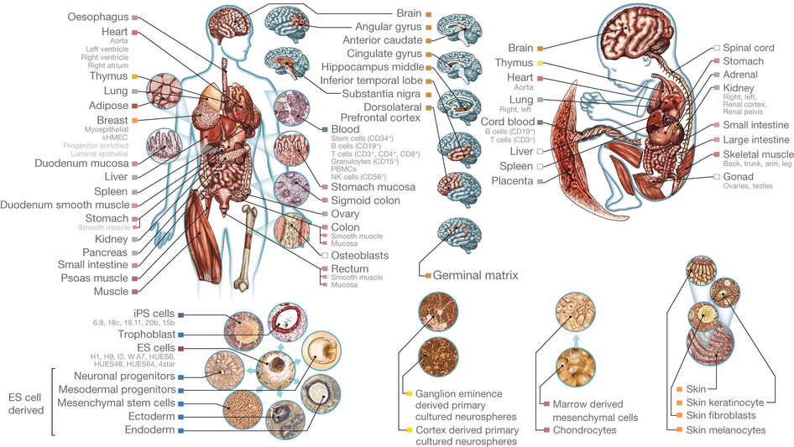
From NIH Roadmap
Notes:
These were all the various tissues examined in Roadmap. Even with all these different tissues, one has to wonder, how fine can we get this resolution of cellular heterogenity?

Slide 4
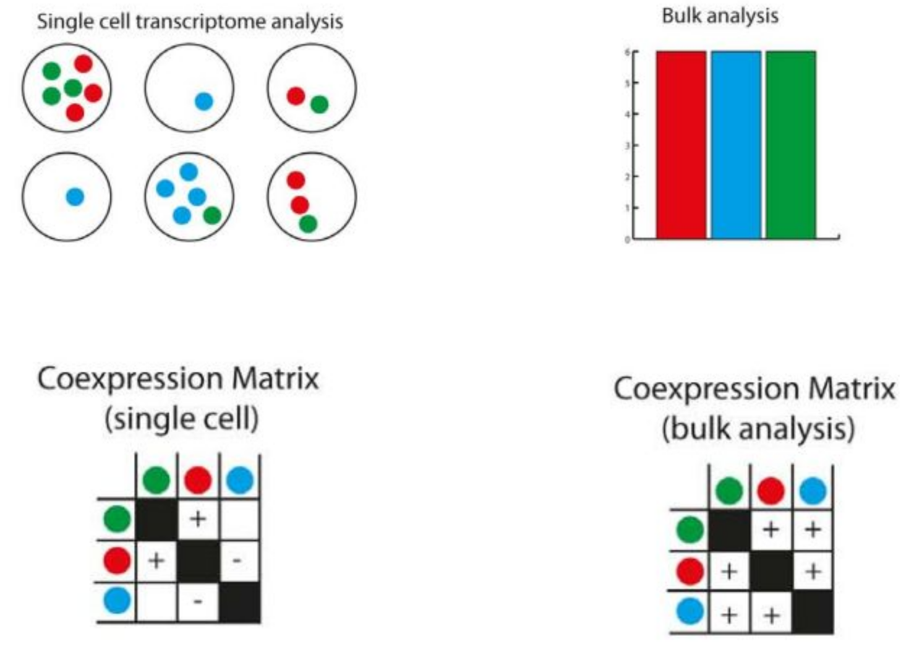
Notes:
For example, imagine these three colors are 3 genes and we want to see if they are co-regulated. Say all the cells on the top left come from one tissue (e.g. lung). If we sequence these in bulk, all three are present, so we may (incorrectly) think that they are all co-expressed.
However, at single cell…
=> scRNA-Seq enables a better discover of reality

Slide 5
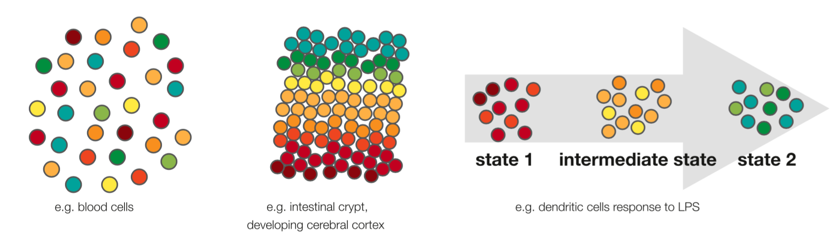
From Kolodziejczyk et al. 2015
Notes:
Most scRNA datasets can be broken up into these three categories
1) No ordering to the cells like pbmcs
2) Spatial information from fixed tissue like the brain
3) Temporal information like forced differentiation

Slide 6
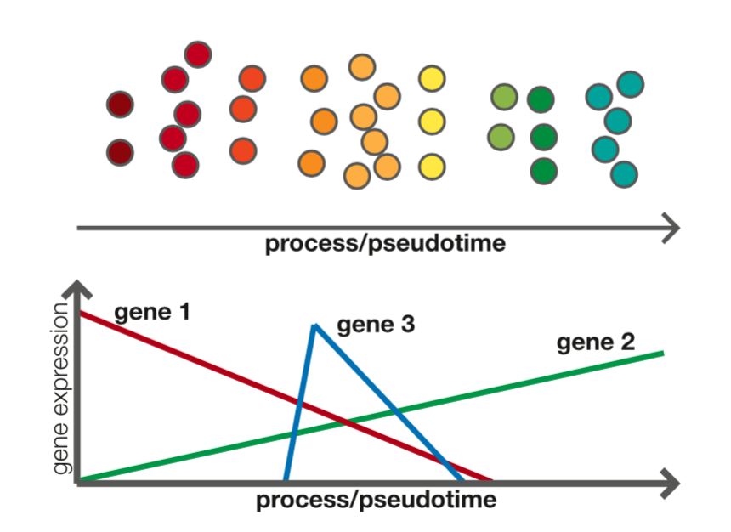
e.g. Hematopoietic Stem Cell
e.g. Monocyte
From Kolodziejczyk et al. 2015
Notes:
Even when there isn’t explicit ordering, we can infer it using a variety of software tools

Slide 7
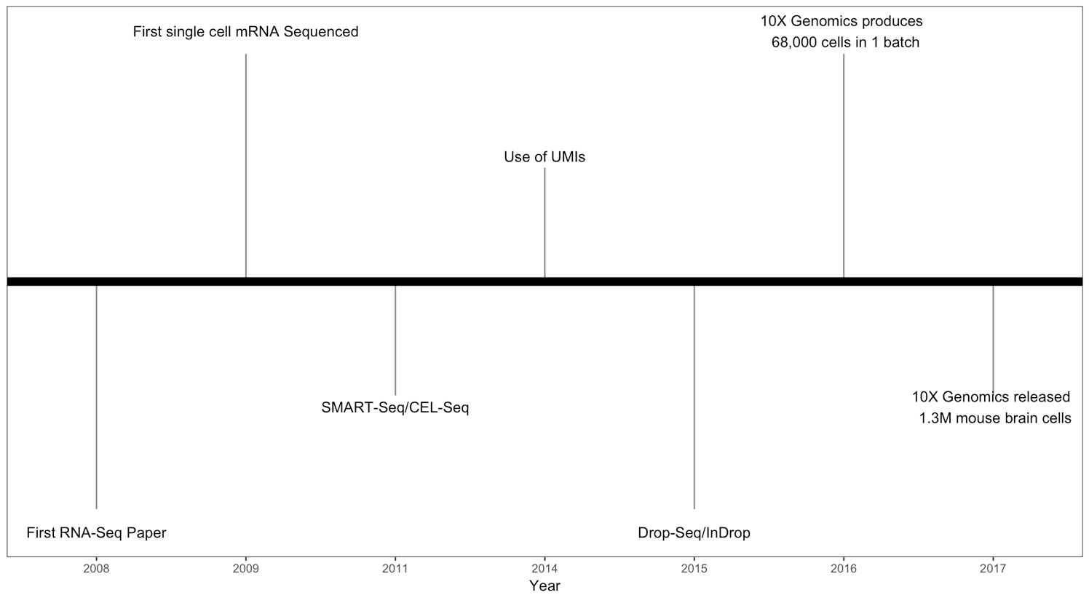
Notes:
Some highlights of scRNA-Seq

Slide 8
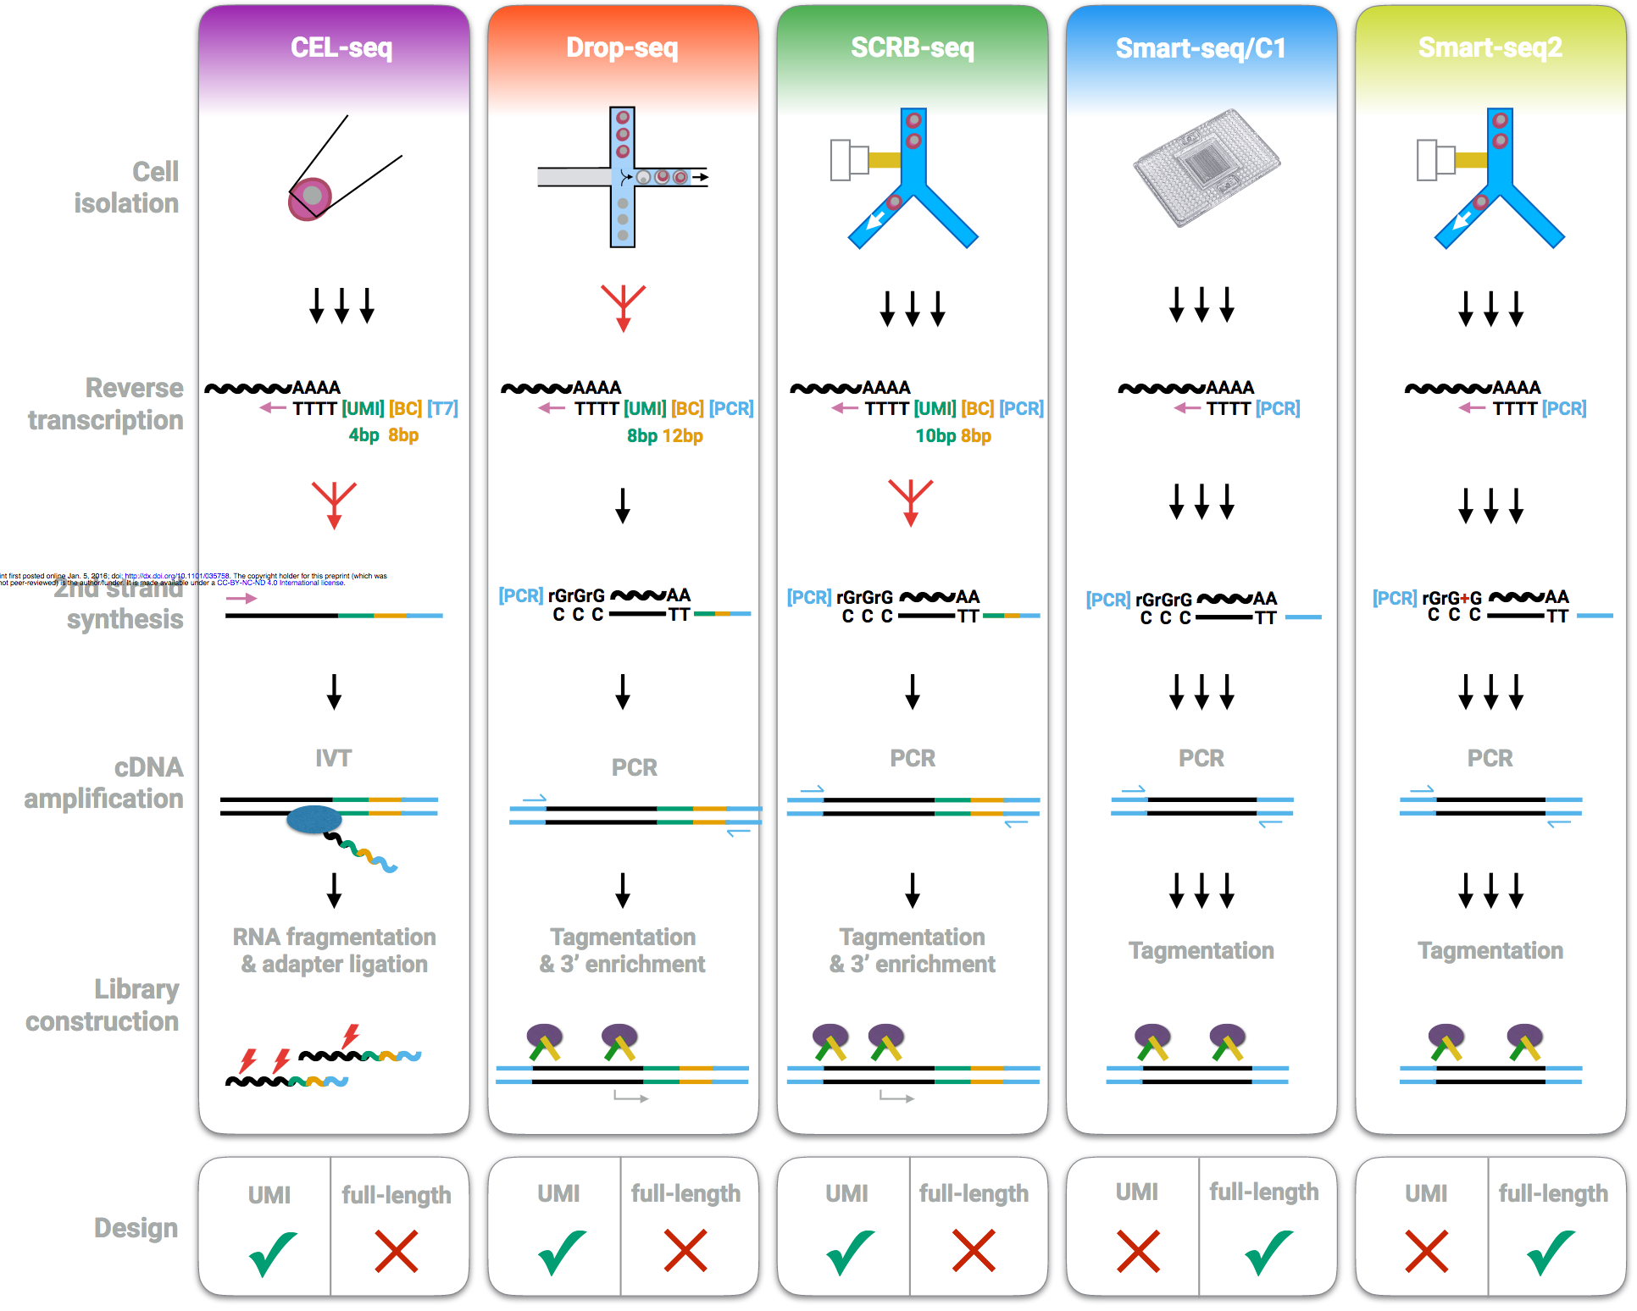
From Ziegenhain et al. 2017
Notes:
Comparison of major techniques.

Slide 9
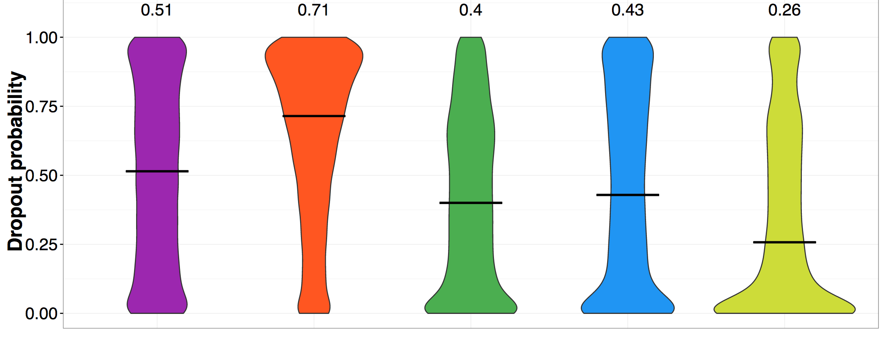
From Ziegenhain et al. 2017
Notes:
Define dropout as a zero in the counts matrix

Slide 10
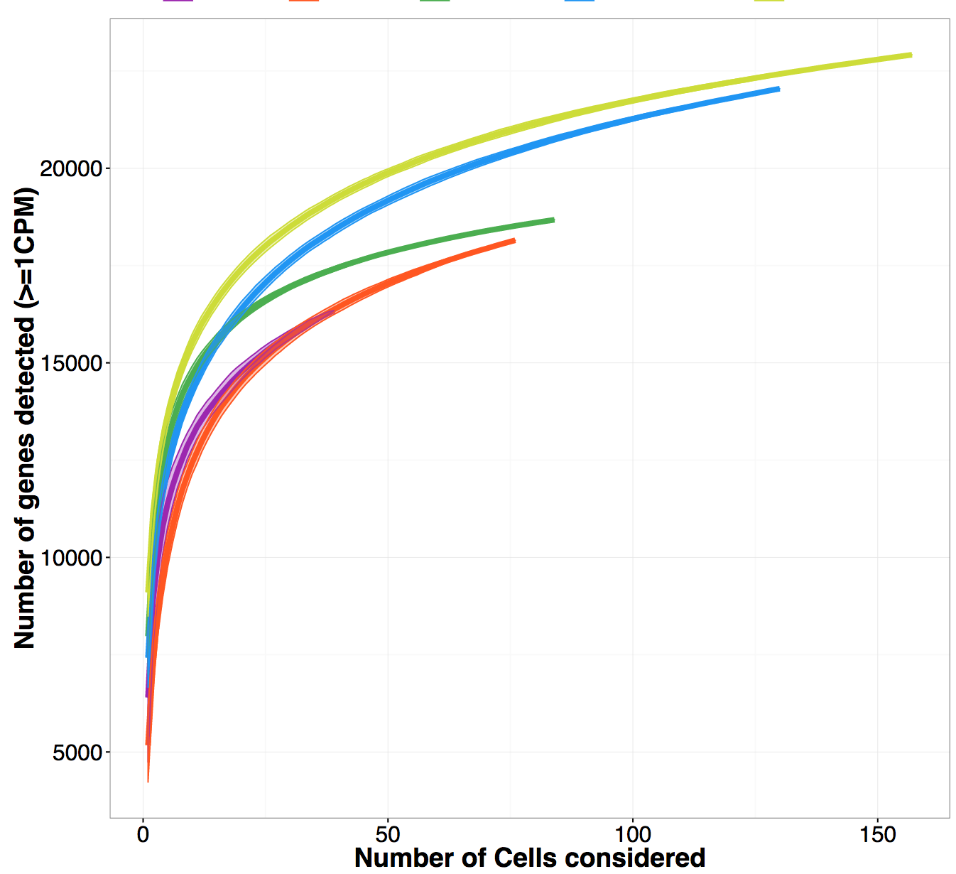
From Ziegenhain et al. 2017

Slide 11
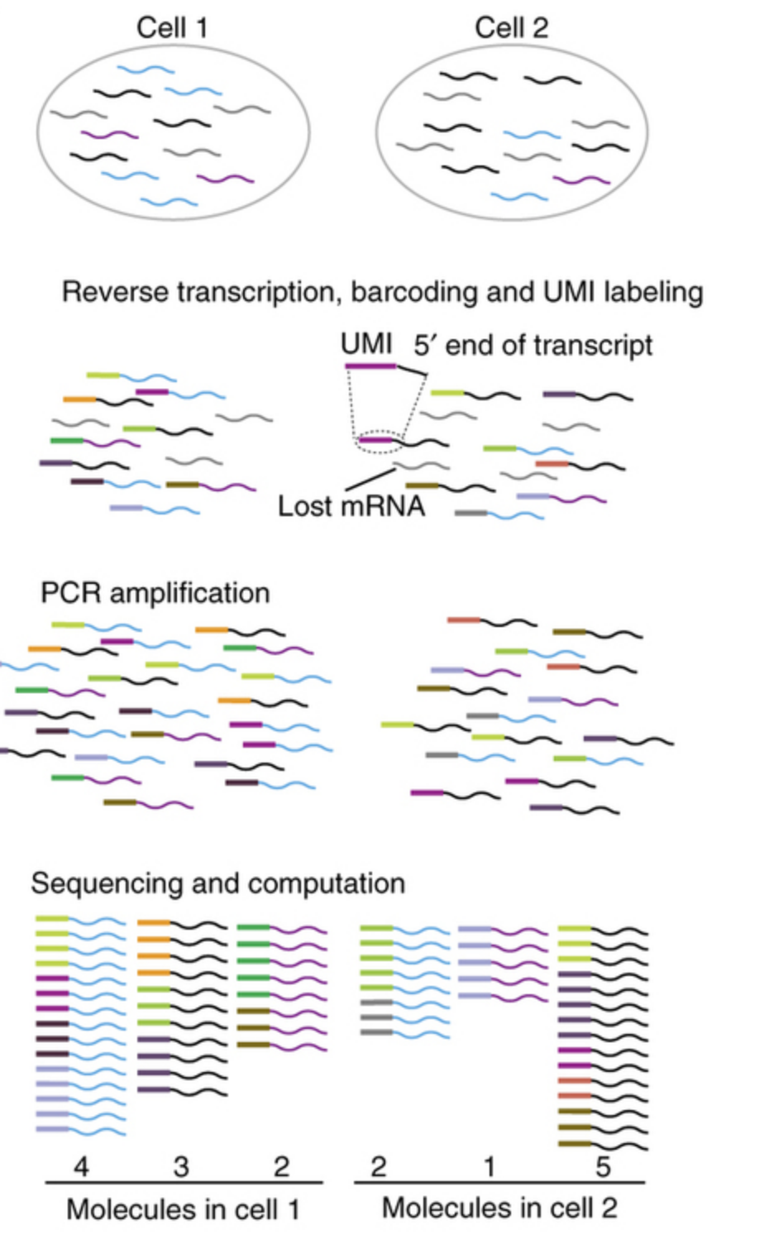
UMIs
Notes:
Tagging mRNA to remove biases from PCR duplications

Slide 12
Notable
Droplet-based (inDrop, Drop-Seq, 10X)
Cheaper/cell
Can produce many more cells/batch
Use UMIs (more robust to PCR bias)
SMART-Seq
Full length (splicing analyses)
Lower dropout/better detection

Slide 13
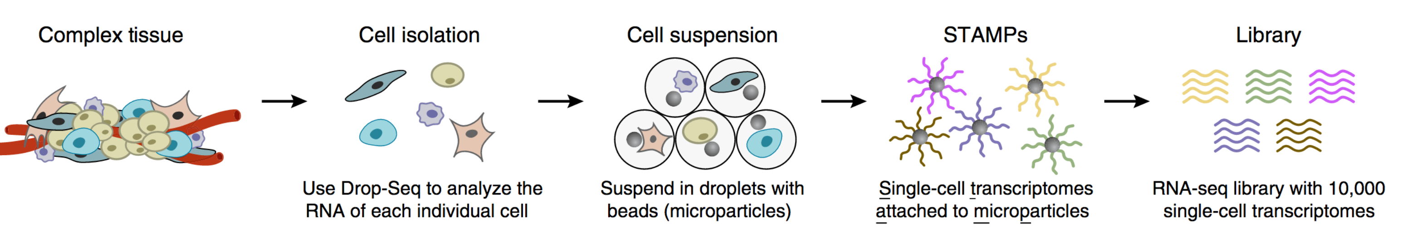
scRNA-Seq in Droplets
From Macosko et al. 2015

Slide 14
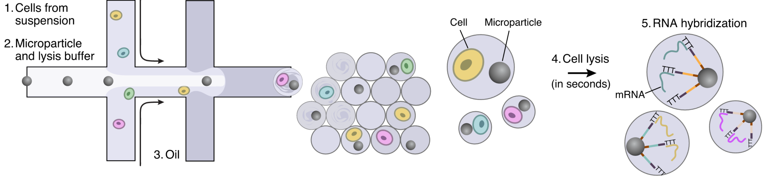
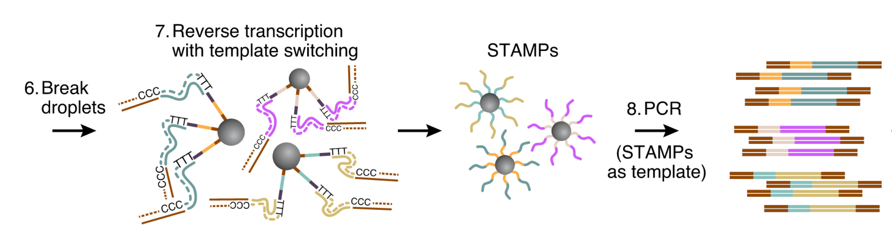
From Macosko et al. 2015
Notes:
Drop-seq overview. Cells mix with reagents in a droplet. RNA attaches to particle with specific barcode, etc, etc.

Slide 15
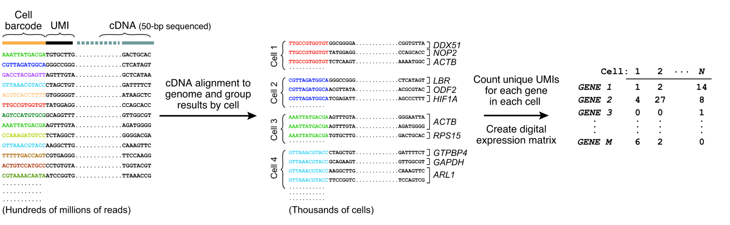
From Macosko et al. 2015

Slide 16
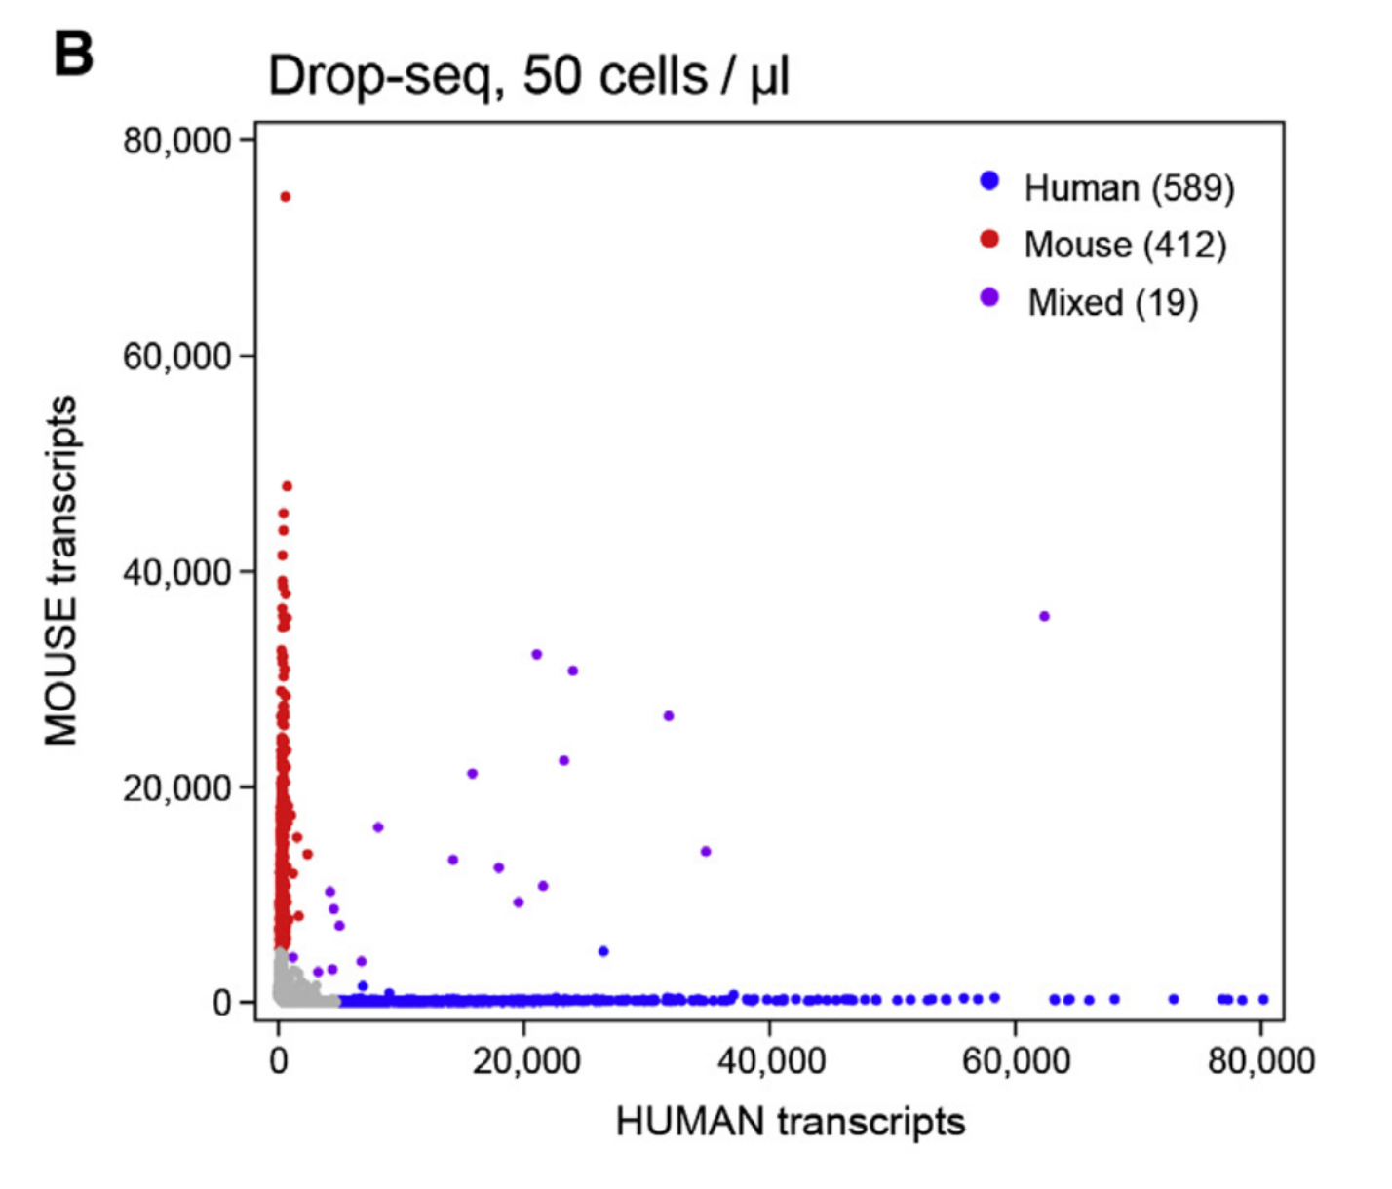
How do you tell if it’s working?
From Macosko et al. 2015
Notes:
Species mixing (key concept)– create a mixture of mouse/human cells. if each barcode has only one cell (which is what we want), should see nothing in purple. This gives us an estimation of the droplet error rate (i.e. one barcode <-> 2+ cells)

Slide 17
Data Analysis

Slide 18
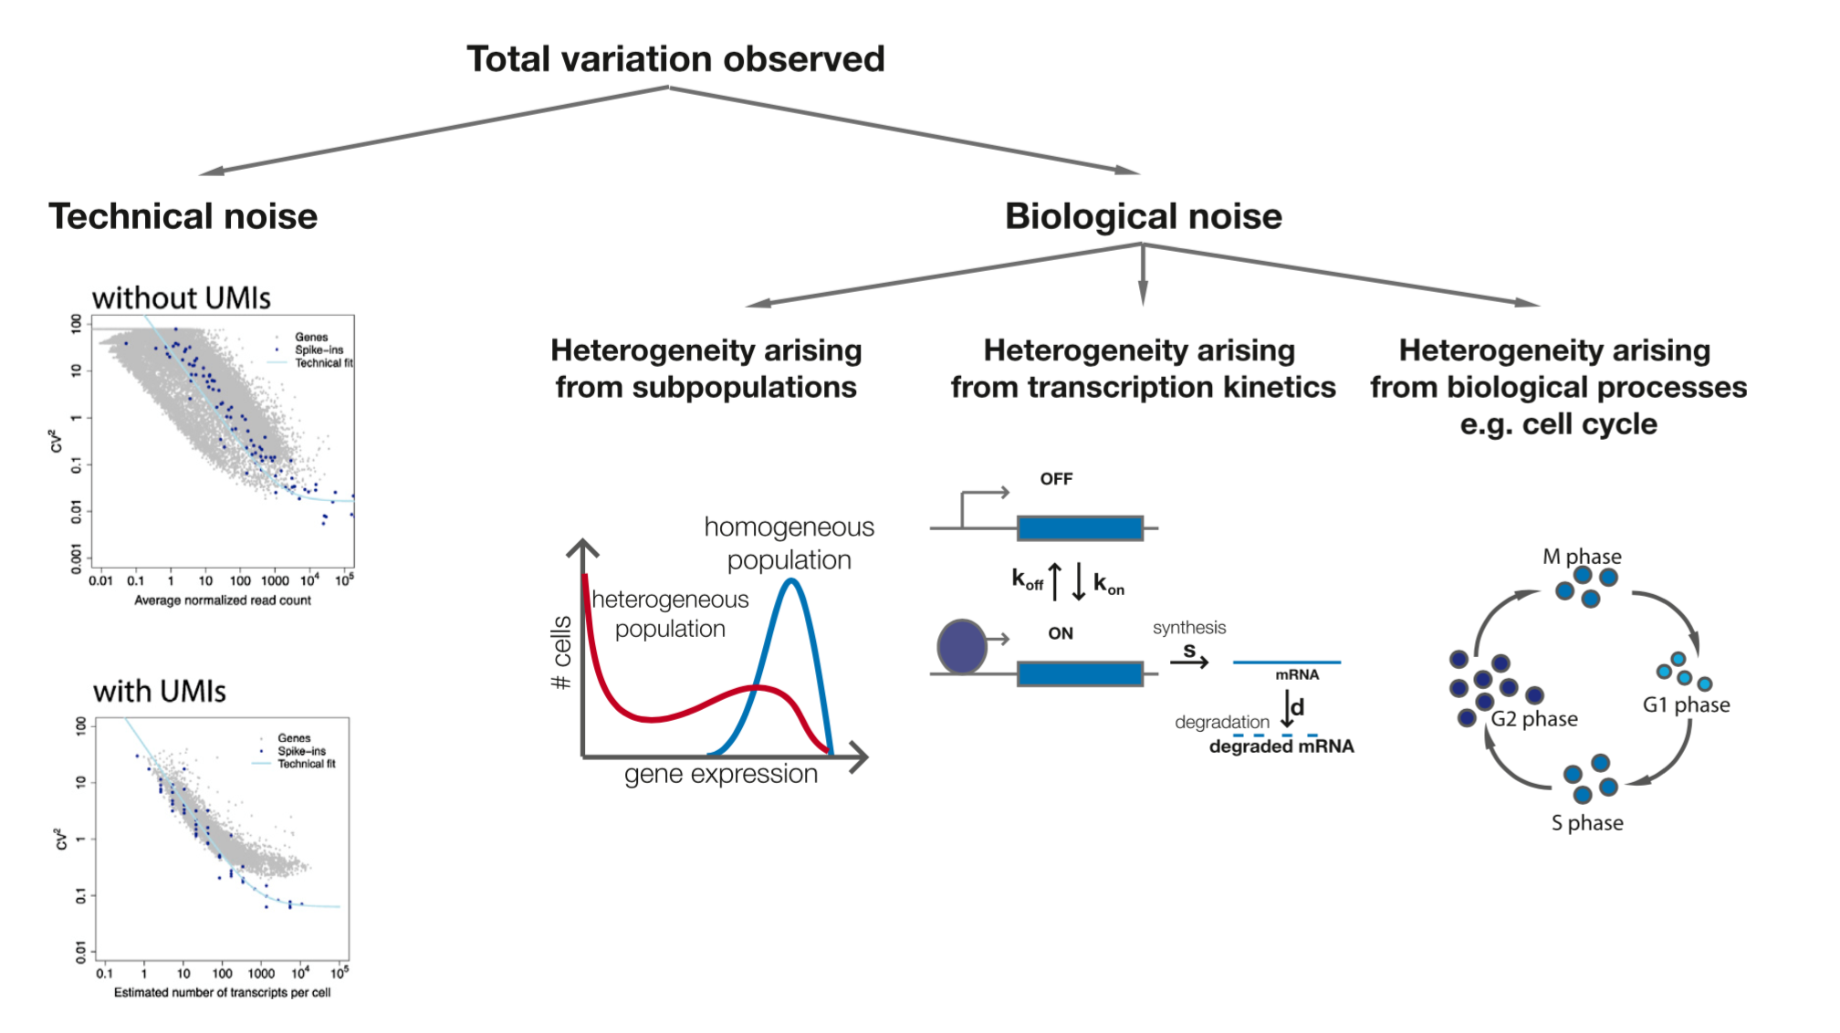
From Kolodziejczyk et al. 2015
Notes:
In each single cell, we observe variations in the gene counts. A good proportion of the variation doesn’t help us discover biology.
UMIs discussed more on other slide; transcription kinetics are largely unknown. Multiple methods have been proposed for cell cycle adjustment but have had limited success

Slide 19
Analysis steps
Filter genes/cells
Principle component analysis
Create per-cell features to account for dropout
Clustering on PCs
Data-driven determination of populations
Discover rare subtypes
2D visualization using tSNE
Non-linear dimension reduction
Characterize clusters/look for biology

Slide 20
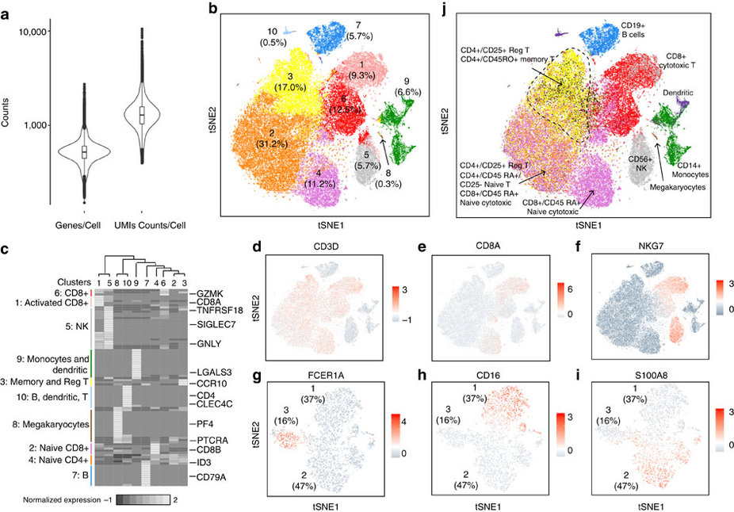
From Zheng et al. 2017
Notes:
Figure 3 from 10X heme paper. 68,000+ PBMCs in a single batch. The figure represents the overal analysis framework for a scRNA-seq pipeline pretty well. A) show distributions of dropouts per cell based on genes and raw counts
B) Results of PCA -> clustering & PCA -> tSNE colored by cluster. Typically include 10-20+ PCs (depending on significance) C) once clusters are defined, look for differential expression between them
D-I) visualize markers that may be differential to see if you can identity clusters based on gene expression signature
J) Related data-driven biomarkers to known/profiled cell types (or maybe you discovered a new one!!) we’ll analyze this dataset for a lab

Slide 21
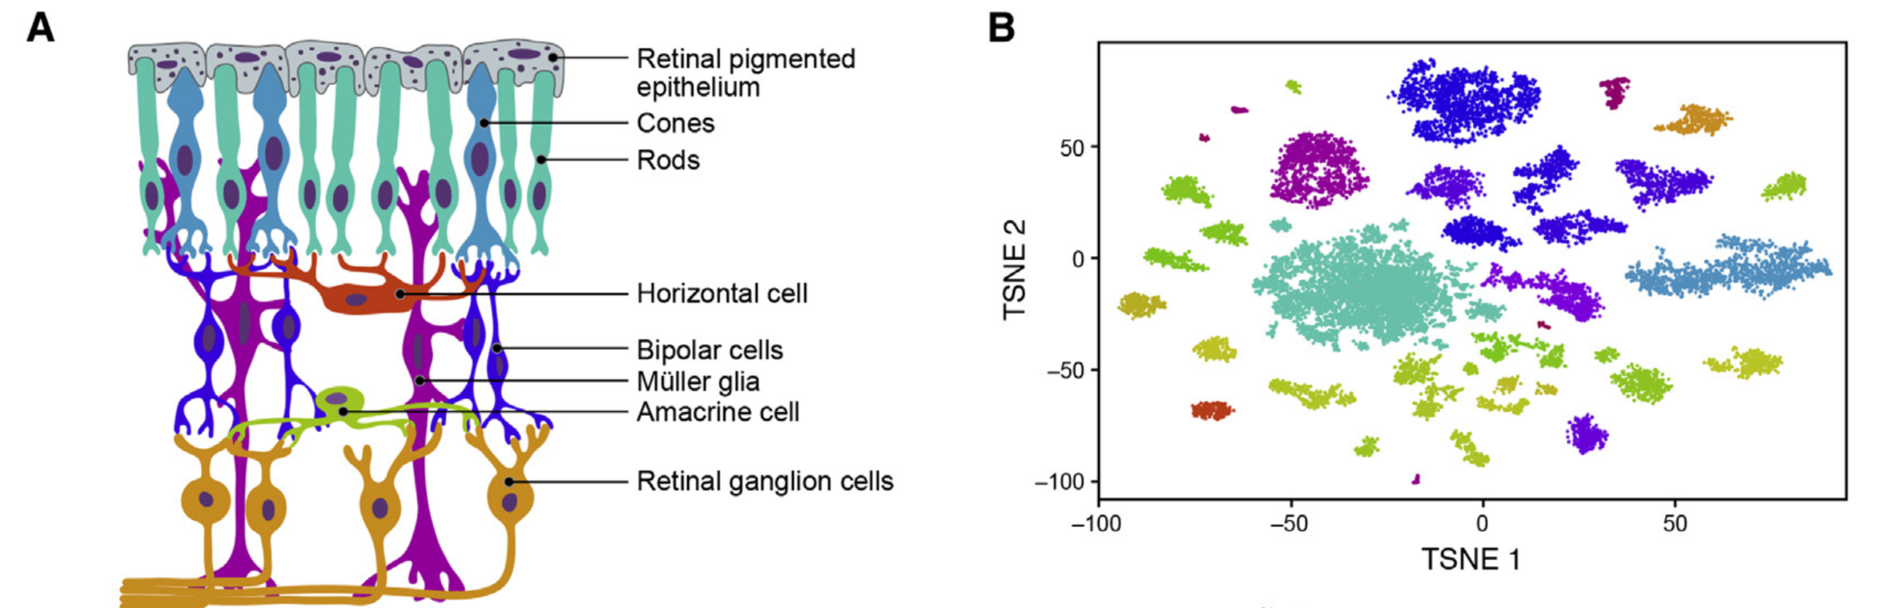
Notes:
Biology from drop-seq paper; colors are consistent. Able to ID these sub populations in the retina

Slide 22
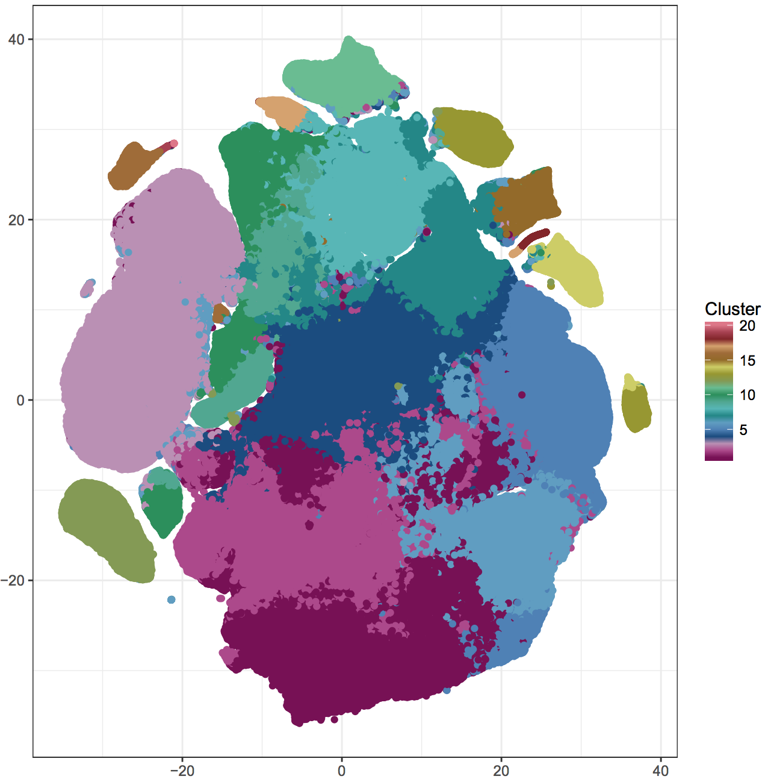
tSNE of 1.3 million cells!
Notes:
Largest sc dataset that’s publically available
This plot shows 1.3 million cells with k= 20 clusters!
For HW 3, you will analyze a piece of this dataset. What are the biological functions of all these clusters?? Let’s find out!

Slide 23
Useful Papers
Kolodziejczyk, Aleksandra A., et al. "The technology and biology of single-cell RNA sequencing." Molecular cell 58.4 (2015): 610-620.
Macosko, Evan Z., et al. "Highly parallel genome-wide expression profiling of individual cells using nanoliter droplets." Cell 161.5 (2015): 1202-1214.
Zheng, Grace XY, et al. "Massively parallel digital transcriptional profiling of single cells." Nature Communications 8 (2017): 14049.
Ziegenhain, Christoph, et al. "Comparative analysis of single-cell RNA sequencing methods." bioRxiv (2016): 035758.

